Slide 1
Machine Learning
Learning from Observations

Slide 2
What is Learning?
Herbert Simon: “Learning is any process by which a system improves performance from experience.”
“A computer program is said to learn from experience E with respect to some class of tasks T and performance measure P, if its performance at tasks in T, as measured by P, improves with experience E.”
– Tom Mitchell

Slide 3
Learning
Learning is essential for unknown environments,
  i.e., when designer lacks omniscience
Learning is useful as a system construction method,
  i.e., expose the agent to reality rather than trying to write it down
Learning modifies the agent's decision mechanisms to improve performance

Slide 4
Machine Learning
Machine learning: how to acquire a model on the basis of data / experience
  Learning parameters (e.g. probabilities)
  Learning structure (e.g. BN graphs)
  Learning hidden concepts (e.g. clustering)

Slide 5
Machine Learning Areas
Supervised Learning: Data and corresponding labels are given
Unsupervised Learning: Only data is given, no labels provided
Semi-supervised Learning: Some (if not all) labels are present
Reinforcement Learning: An agent interacting with the world makes observations, takes actions, and is rewarded or punished; it should learn to choose actions in such a way as to obtain a lot of reward

Slide 6
Supervised Learning : Important Concepts
Data: labeled instances <x_{i}, y>, e.g. emails marked spam/not spam
  Training Set
  Held-out Set
  Test Set
Features: attribute-value pairs which characterize each x
Experimentation cycle
  Learn parameters (e.g. model probabilities) on training set
  (Tune hyper-parameters on held-out set)
  Compute accuracy of test set
  Very important: never “peek” at the test set!
Evaluation
  Accuracy: fraction of instances predicted correctly
Overfitting and generalization
  Want a classifier which does well on test data
  Overfitting: fitting the training data very closely, but not generalizing well

Slide 7
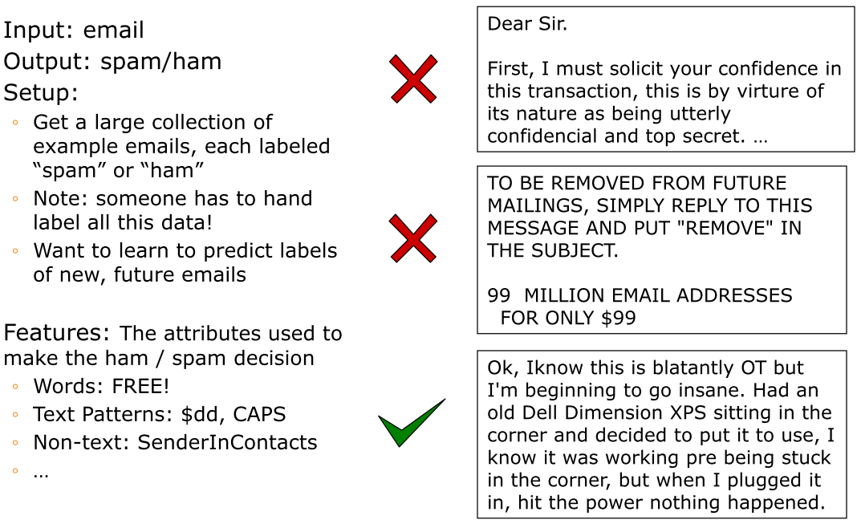
Example: Spam Filter
Slide from Mackassy

Slide 8
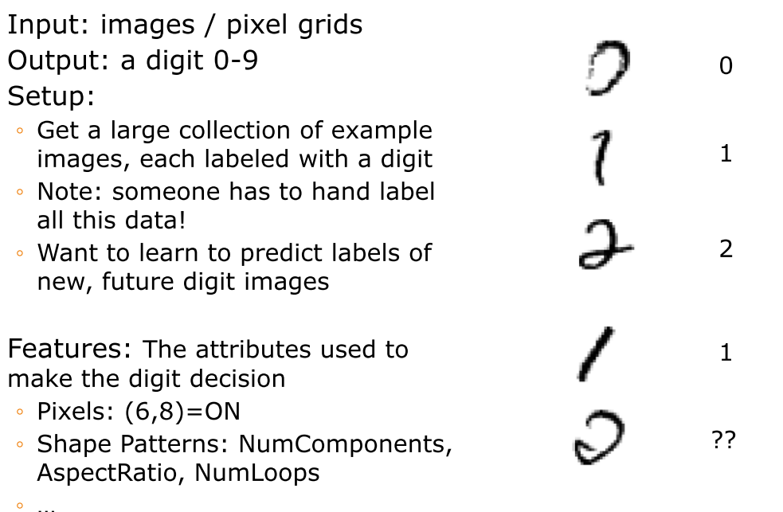
Example: Digit Recognition
Slide from Mackassy

Slide 9
Classification Examples
In classification, we predict labels y (classes) for inputs x
Examples:
  OCR (input: images, classes: characters)
  Medical diagnosis (input: symptoms, classes: diseases)
  Automatic essay grader (input: document, classes: grades)
  Fraud detection (input: account activity, classes: fraud / no fraud)
  Customer service email routing
  Recommended articles in a newspaper, recommended books
  DNA and protein sequence identification
  Categorization and identification of astronomical images
  Financial investments
  … many more

Slide 10
Inductive learning
Simplest form: learn a function from examples
f is the target function
An example is a pair (x, f(x))
Pure induction task:
  Given a collection of examples of f, return a function h that approximates f.
  find a hypothesis h, such that h ≈ f, given a training set of examples
(This is a highly simplified model of real learning:
  Ignores prior knowledge
  Assumes examples are given)

Slide 11
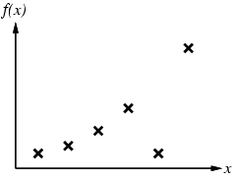
Inductive learning method
Construct/adjust h to agree with f on training set
(h is consistent if it agrees with f on all examples)
E.g., curve fitting:

Slide 12
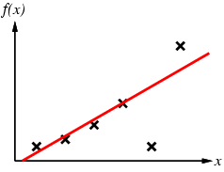
Inductive learning method
Construct/adjust h to agree with f on training set
(h is consistent if it agrees with f on all examples)
E.g., curve fitting:

Slide 13
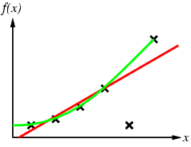
Inductive learning method
Construct/adjust h to agree with f on training set
(h is consistent if it agrees with f on all examples)
E.g., curve fitting:

Slide 14
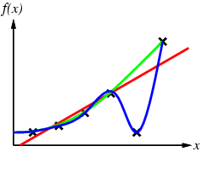
Inductive learning method
Construct/adjust h to agree with f on training set
(h is consistent if it agrees with f on all examples)
E.g., curve fitting:

Slide 15
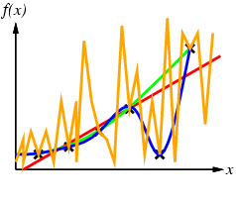
Inductive learning method
Construct/adjust h to agree with f on training set
(h is consistent if it agrees with f on all examples)
E.g., curve fitting:

Slide 16
Inductive learning method
Construct/adjust h to agree with f on training set
(h is consistent if it agrees with f on all examples)
E.g., curve fitting:
Ockham’s razor: prefer the simplest hypothesis consistent with data

Slide 17
Generalization
Hypotheses must generalize to correctly classify instances not in the training data.
Simply memorizing training examples is a consistent hypothesis that does not generalize.
Occam’s razor:
  Finding a simple hypothesis helps ensure generalization.

Slide 18
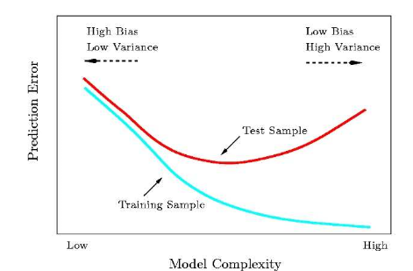
Training Error vs Test Error

Slide 19
Supervised Learning
Learning a discrete function: Classification
  Boolean classification:
    Each example is classified as true(positive) or false(negative).
Learning a continuous function: Regression

Slide 20
Classification—A Two-Step Process
Model construction: describing a set of predetermined classes
  Each tuple/sample is assumed to belong to a predefined class, as determined by the class label
  The set of tuples used for model construction is training set
  The model is represented as classification rules, decision trees, or mathematical formulae
Model usage: for classifying future or unknown objects
  Estimate accuracy of the model
    The known label of test sample is compared with the classified result from the model
    Test set is independent of training set, otherwise over-fitting will occur
  If the accuracy is acceptable, use the model to classify data tuples whose class labels are not known
Data Mining: Concepts and Techniques

Slide 21

Illustrating Classification Task

Slide 22
Issues: Data Preparation
Data cleaning
  Preprocess data in order to reduce noise and handle missing values
Relevance analysis (feature selection)
  Remove the irrelevant or redundant attributes
Data transformation
  Generalize data to (higher concepts, discretization)
  Normalize attribute values
Data Mining: Concepts and Techniques

Slide 23
Classification Techniques
Decision Tree based Methods
Rule-based Methods
Naïve Bayes and Bayesian Belief Networks
Neural Networks
Support Vector Machines
and more...

Slide 24
Learning decision trees
Example Problem: decide whether to wait for a table at a restaurant, based on the following attributes:
  Alternate: is there an alternative restaurant nearby?
  Bar: is there a comfortable bar area to wait in?
  Fri/Sat: is today Friday or Saturday?
  Hungry: are we hungry?
  Patrons: number of people in the restaurant (None, Some, Full)
  Price: price range ($, $$, $$$)
  Raining: is it raining outside?
  Reservation: have we made a reservation?
  Type: kind of restaurant (French, Italian, Thai, Burger)
  WaitEstimate: estimated waiting time (0-10, 10-30, 30-60, >60)

Slide 25
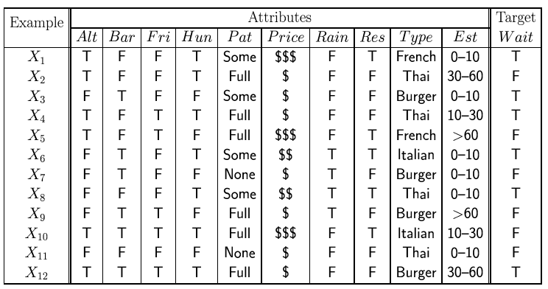
Feature(Attribute)-based representations
Examples described by feature(attribute) values
  (Boolean, discrete, continuous)
E.g., situations where I will/won't wait for a table:
Classification of examples is positive (T) or negative (F)

Slide 26
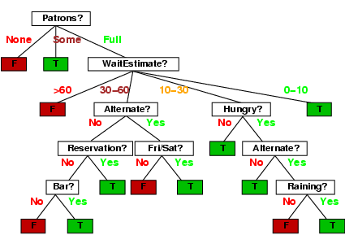
Decision trees
One possible representation for hypotheses
E.g., here is the “true” tree for deciding whether to wait:

Slide 27
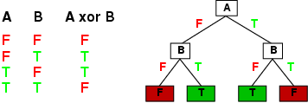
Expressiveness
Decision trees can express any function of the input attributes.
E.g., for Boolean functions, truth table row → path to leaf:
Trivially, there is a consistent decision tree for any training set with one path to leaf for each example (unless f nondeterministic in x) but it probably won't generalize to new examples
Prefer to find more compact decision trees

Slide 28
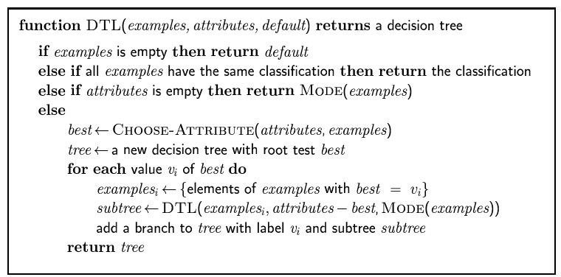
Decision tree learning
Aim: find a small tree consistent with the training examples
Idea: (recursively) choose "most significant" attribute as root of (sub)tree

Slide 29
Decision Tree Construction Algorithm
Principle
  Basic algorithm (adopted by ID3, C4.5 and CART): a greedy algorithm
  Tree is constructed in a top-down recursive divide-and-conquer manner
Iterations
  At start, all the training tuples are at the root
  Tuples are partitioned recursively based on selected attributes
  Test attributes are selected on the basis of a heuristic or statistical measure (e.g, information gain)
Stopping conditions
  All samples for a given node belong to the same class
  There are no remaining attributes for further partitioning – majority voting is employed for classifying the leaf
  There are no samples left

Slide 30
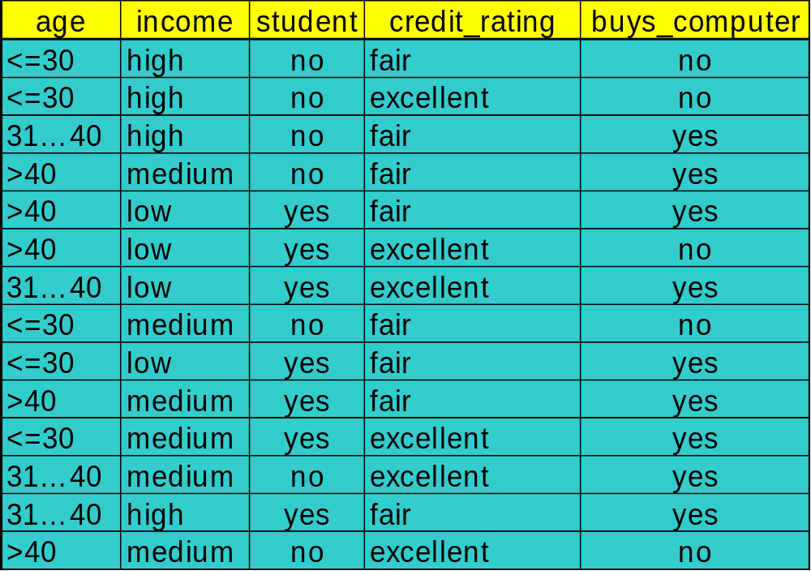
Decision Tree Induction: Training Dataset
This follows an example of Quinlan’s ID3 (Playing Tennis)
Data Mining: Concepts and Techniques

Slide 31
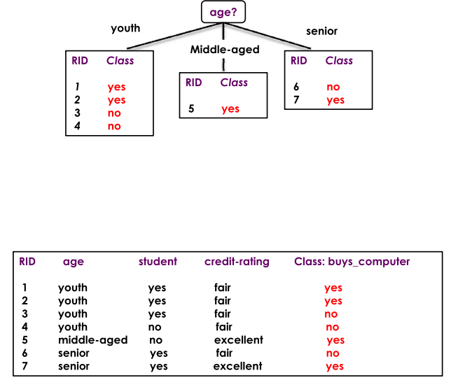
Example

Slide 32
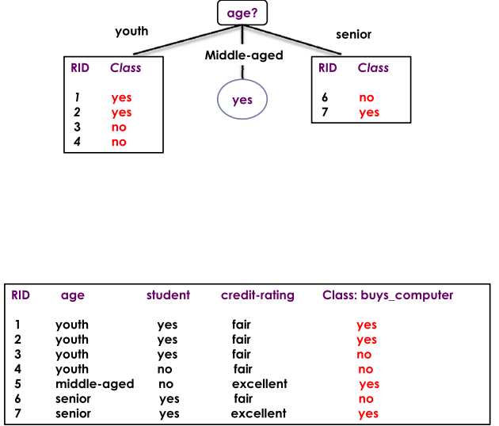
Example

Slide 33
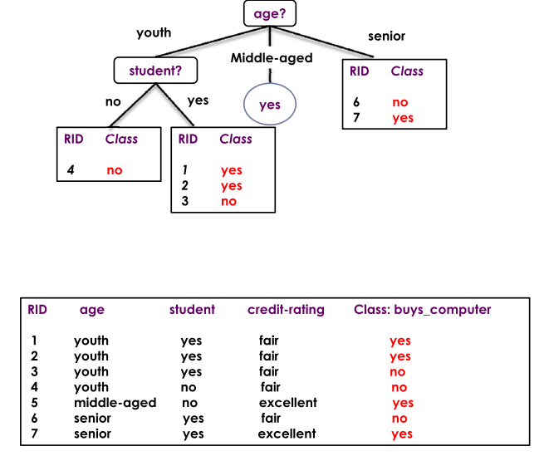
Example

Slide 34
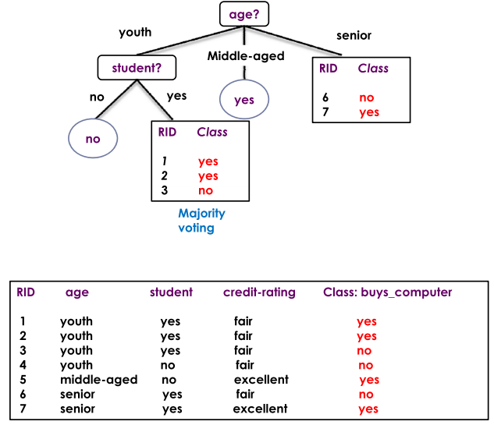
Example

Slide 35
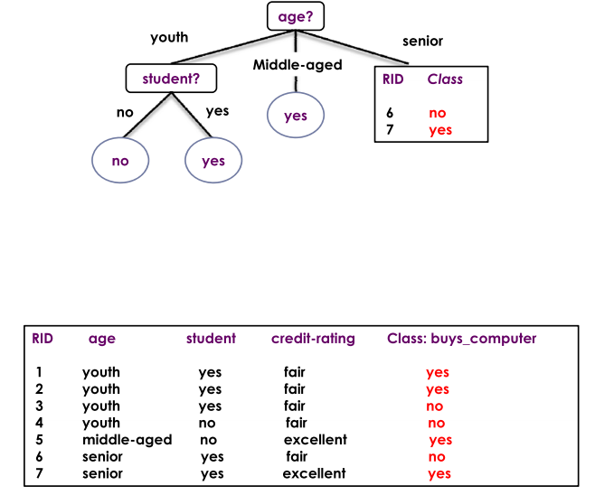
Example

Slide 36
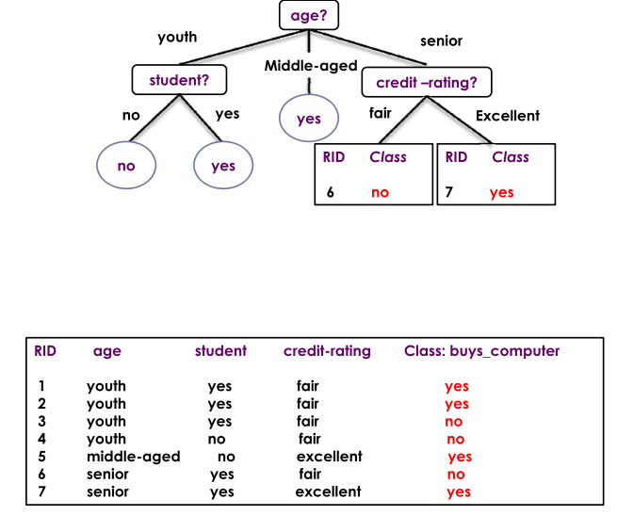
Example

Slide 37
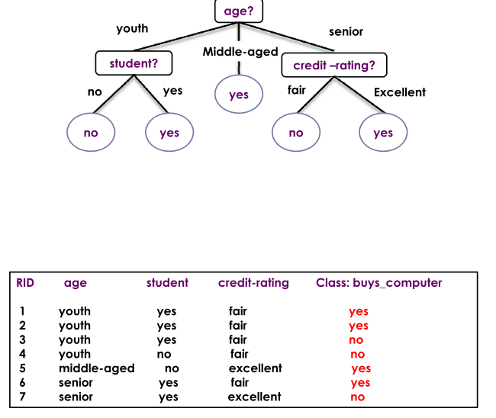
Example

Slide 38
Tree Induction
Greedy strategy.
  Split the records based on an attribute test that optimizes certain criterion.
Issues
  Determine how to split the records
    How to specify the attribute test condition?
    How to determine the best split?
  Determine when to stop splitting

Slide 39
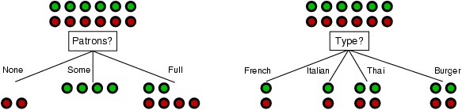
Choosing an attribute
Idea: a good attribute splits the examples into subsets that are (ideally) "all positive" or "all negative"
Patrons? is a better choice

Slide 40
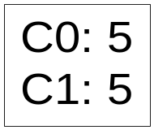

How to determine the Best Split
Greedy approach:
  Nodes with homogeneous class distribution are preferred
Need a measure of node impurity:
Non-homogeneous,
High degree of impurity
Homogeneous,
Low degree of impurity

Slide 41
Measures of Node Impurity
Information Gain
Gini Index
Misclassification error
Choose attributes to split to achieve minimum impurity

Slide 42
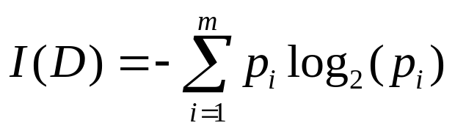
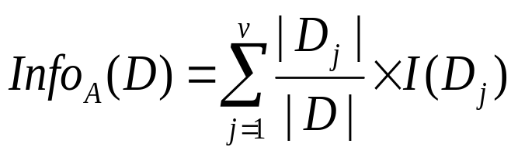

Attribute Selection Measure: Information Gain (ID3/C4.5)
Select the attribute with the highest information gain
Let p_{i} be the probability that an arbitrary tuple in D belongs to class C_{i}, estimated by |C_{i, D}|/|D|
Expected information (entropy) needed to classify a tuple in D:
Information needed (after using A to split D into v partitions) to classify D:
Information gained by branching on attribute A
Data Mining: Concepts and Techniques
Notes:
I : the expected information needed to classify a given sample
E (entropy) : expected information based on the partitioning into subsets by A

Slide 43
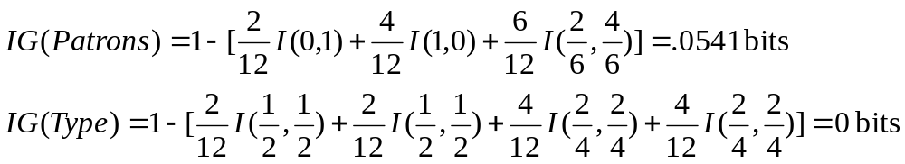
Information gain
For the training set, p = n = 6, I(6/12, 6/12) = 1 bit
Consider the attributes Patrons and Type (and others too):
Patrons has the highest IG of all attributes and so is chosen by the DTL algorithm as the root

Slide 44
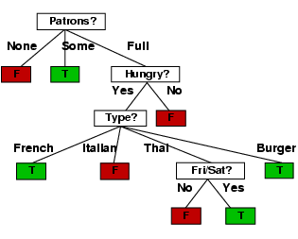
Example contd.
Decision tree learned from the 12 examples:
Substantially simpler than “true” tree---a more complex hypothesis isn’t justified by small amount of data

Slide 45

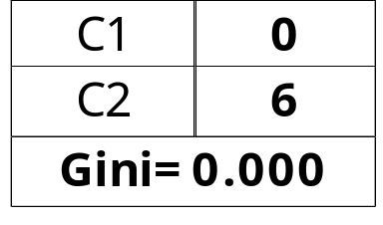

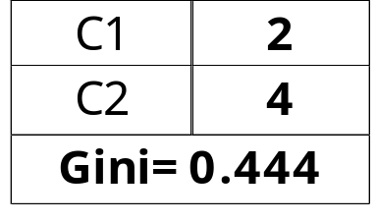
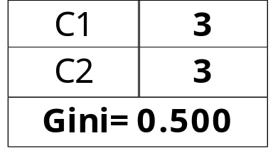
Measure of Impurity: GINI
(CART, IBM IntelligentMiner)
Gini Index for a given node t :
    (NOTE: p( j | t) is the relative frequency of class j at node t).
  Maximum (1 - 1/n_{c}) when records are equally distributed among all classes, implying least interesting information
  Minimum (0.0) when all records belong to one class, implying most interesting information

Slide 46

Splitting Based on GINI
Used in CART, SLIQ, SPRINT.
When a node p is split into k partitions (children), the quality of split is computed as,
where, n_{i} = number of records at child i,
n = number of records at node p.

Slide 47
Comparison of Attribute Selection Methods
The three measures return good results but
  Information gain:
    biased towards multivalued attributes
  Gain ratio:
    tends to prefer unbalanced splits in which one partition is much smaller than the others
  Gini index:
    biased to multivalued attributes
    has difficulty when # of classes is large
    tends to favor tests that result in equal-sized partitions and purity in both partitions
Data Mining: Concepts and Techniques

Slide 48
Example Algorithm: C4.5
Simple depth-first construction.
Uses Information Gain
Sorts Continuous Attributes at each node.
Needs entire data to fit in memory.
Unsuitable for Large Datasets.
You can download the software from Internet

Slide 49
Decision Tree Based Classification
Advantages:
  Easy to construct/implement
  Extremely fast at classifying unknown records
  Models are easy to interpret for small-sized trees
  Accuracy is comparable to other classification techniques for many simple data sets
  Tree models make no assumptions about the distribution of the underlying data : nonparametric
  Have a built-in feature selection method that makes them immune to the presence of useless variables

Slide 50
Decision Tree Based Classification
Disadvantages
  Computationally expensive to train
  Some decision trees can be overly complex that do not generalise the data well.
  Less expressivity: There may be concepts that are hard to learn with limited decision trees

Slide 51
Overfitting and Tree Pruning
Overfitting: An induced tree may overfit the training data
  Too many branches, some may reflect anomalies due to noise or outliers
  Poor accuracy for unseen samples
Two approaches to avoid overfitting
  Prepruning: Halt tree construction early—do not split a node if this would result in the goodness measure falling below a threshold
    Difficult to choose an appropriate threshold
  Postpruning: Remove branches from a “fully grown” tree—get a sequence of progressively pruned trees
    Use a set of data different from the training data to decide which is the “best pruned tree”
Data Mining: Concepts and Techniques

Slide 52
Rule-Based Classifier
Classify records by using a collection of “if…then…” rules
Rule: (Condition) → y
  where
    Condition is a conjunctions of attributes
    y is the class label
  LHS: rule antecedent or condition
  RHS: rule consequent
  Examples of classification rules:
    (Blood Type=Warm) ∧ (Lay Eggs=Yes) → Birds
    (Taxable Income < 50K) ∧ (Refund=Yes) → Evade=No

Slide 53
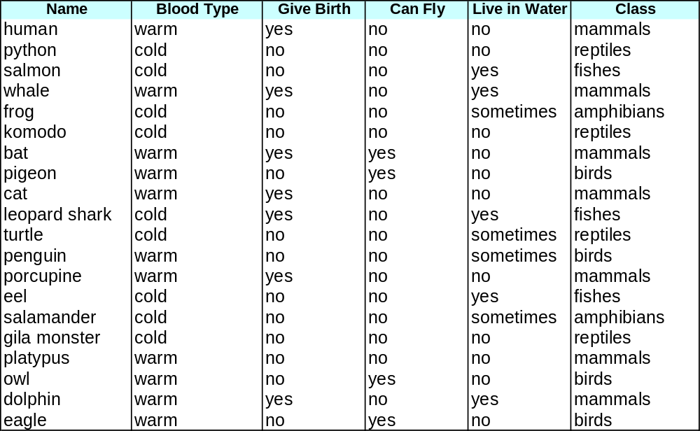
Rule-based Classifier (Example)
R1: (Give Birth = no) ∧ (Can Fly = yes) → Birds
R2: (Give Birth = no) ∧ (Live in Water = yes) → Fishes
R3: (Give Birth = yes) ∧ (Blood Type = warm) → Mammals
R4: (Give Birth = no) ∧ (Can Fly = no) → Reptiles
R5: (Live in Water = sometimes) → Amphibians

Slide 54
Rule Extraction from a Decision Tree
Rules are easier to understand than large trees
One rule is created for each path from the root to a leaf
Each attribute-value pair along a path forms a conjunction: the leaf holds the class prediction
age?
<=30
31..40
>40
student?
yes
credit rating?
no
yes
excellent
fair
no
yes
no
yes
Example: Rule extraction from our buys_computer decision-tree
  IF age = young AND student = no THEN buys_computer = no
  IF age = young AND student = yes THEN buys_computer = yes
  IF age = mid-age THEN buys_computer = yes
  IF age = old AND credit_rating = excellent THEN buys_computer = yes
  IF age = young AND credit_rating = fair THEN buys_computer = no
Data Mining: Concepts and Techniques

Slide 55
Extra Slides

Slide 56
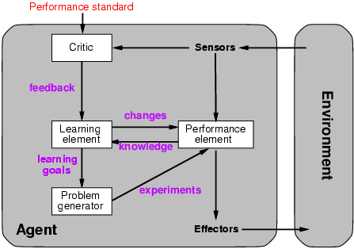
Learning agents

Slide 57
Classification(Sınıflandırma)
IDEA: Build a model based on past data to predict the class of the new data
Given a collection of records (training set )
  Each record contains a set of attributes, one of the attributes is the class.
Find a model for class attribute as a function of the values of other attributes.
Goal: previously unseen records should be assigned a class as accurately as possible.

Slide 58
Hypothesis spaces
How many distinct decision trees with n Boolean attributes?
= number of Boolean functions
= number of distinct truth tables with 2^{n} rows = 2^{2n}
E.g., with 6 Boolean attributes, there are 18,446,744,073,709,551,616 trees
How many purely conjunctive hypotheses (e.g., Hungry ∧ ¬Rain)?
Each attribute can be in (positive), in (negative), or out
  ⇒ 3^{n} distinct conjunctive hypotheses
More expressive hypothesis space
  increases chance that target function can be expressed
  increases number of hypotheses consistent with training set
  ⇒ may get worse predictions

Slide 59
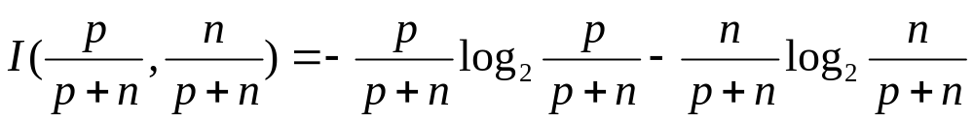
Using information theory
To implement Choose-Attribute in the DTL algorithm
Information Content (Entropy):
I(P(v₁), … , P(v_{n})) = Σ_{i=1} -P(v_{i}) log₂ P(v_{i})
For a training set containing p positive examples and n negative examples:

Slide 60
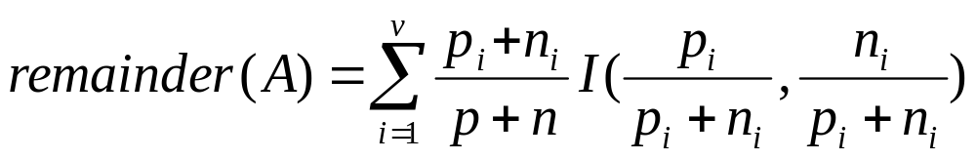
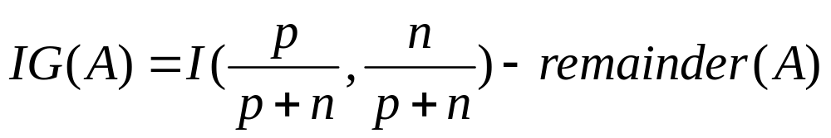
Information gain
A chosen attribute A divides the training set E into subsets E₁, … , E_{v} according to their values for A, where A has v distinct values.
Information Gain (IG) or reduction in entropy from the attribute test:
Choose the attribute with the largest IG

Slide 61
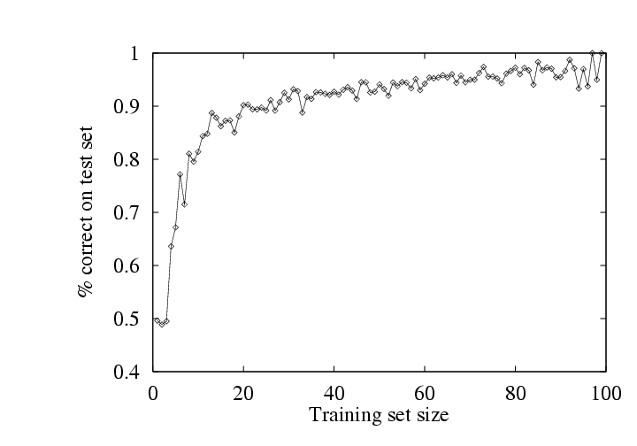
Performance measurement
How do we know that h ≈ f ?
  Use theorems of computational/statistical learning theory
  Try h on a new test set of examples
    (use same distribution over example space as training set)
Learning curve = % correct on test set as a function of training set size

